Slide 1
Are wages in Eastern Europe too low?
Jan Drahokoupil
Senior Researcher
European Trade Union Institute, Brussels
Event
Notes:
Shifting focus from employment to working conditions
Wages but also job quality

Slide 2
Approaches
Wage levels/GDP (Prague conference etc.)
Wage share (Prague conference, Stockhammer)
∆Productivity/∆wage, ∆ULC (Prague conference etc.)
EUR equilibrium wage levels/shares = f(capital productivity, capital intensity, price effects) (Collignon & Esposito 2016)
Employment structure

Slide 3
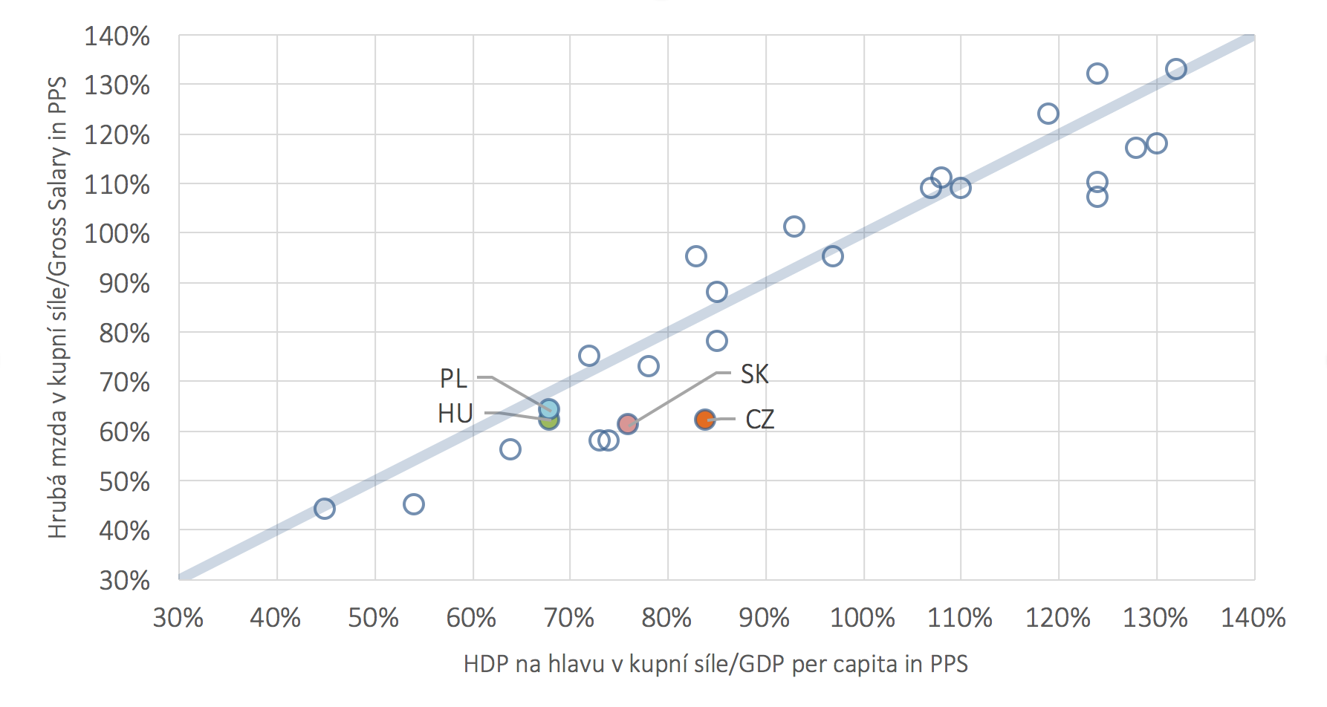
Wage levels/GDP (figure by Chmelař)
Notes:
PL HU as most countries seem OK (PL too high on some indicators)
SK CZ should increase wages
What if GDP low as output price low (outsourcing)?
What if GDP low as wages low? (not independent)

Slide 4
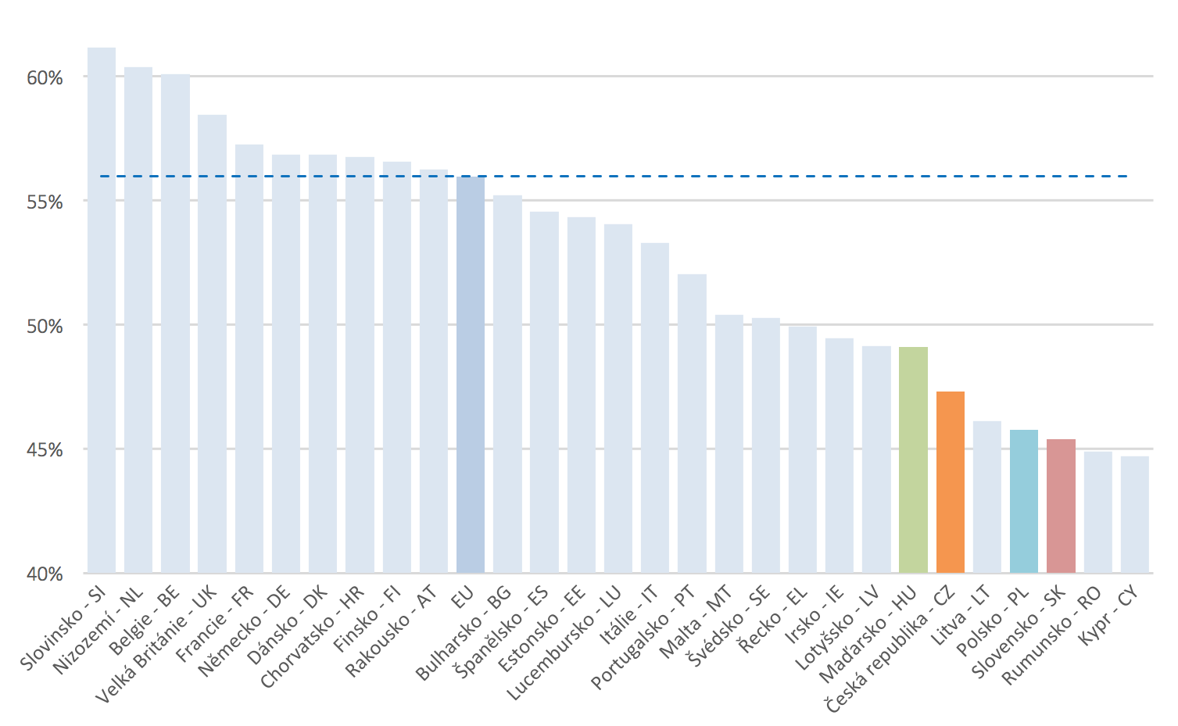
Another figure from Prague by Chmelař: Wage share
Notes:
SI, BG, EE doing quite well
CZ PL RO etc not good
BTW PL doing well on wage level/GDP
Problems: (if not adjusted) self employees, pensions/public sector will influence
Government consumption 100% wage share (no profits)
Wage share should be related to capital productivity: if higher productivity/intensity can afford to pay higher wages

Slide 5
Hence: private, adjusted wage share (Stockhammer)
Notes:
Only older data
Many countries missing

Slide 6
Private, adjusted wage share 2
Notes:
So I replicated with Ameco data, but got much lower wage shares (order seems to be right)
SI BG EE HR doing quite well (not on the previous slide), because more matching high capital productivity (still could be higher in later data)
BG not consistent with Stockhammer

Slide 7
Adjusted wage share: manufacturing industry (Amex)
Notes:
Compensation per employee as percentage of nominal gross value added per person employed
HR EE SI doing quite well
Pushes up wage share in CZ SK
Lower gap from DE

Slide 8
EUR equilibrium wage levels/shares vs actual wages nominal f(labour productivity, equilibrium wage share) -> real f(capital productivity, capital intensity, price effects)
wage gap in % to equilibrium
Notes:
SI EE BG now undervalued despite larger wage share (still less than the rest)
IE LU driven by profits/output reported there (indication of a problem of this methodology)

Slide 9
Notes:
The sectoral dynamics of the relative ACE provides an interesting explanation for the competitiveness gain in terms of rising equilibrium wages in the manufacturing sector before the global financial crisis. In Germany, Austria and the Netherlands this effect is driven essentially by capital accumulation whereas in the two CEECs the catching up in terms of output growth can explain the result. After the crisis, the overall change was rather low and with less significant sectoral differences. The service sector does not seem to be particularly affected by important changes in both periods. Important exceptions are, in any case, the post-crisis effect in Italy and Poland. In the former, services partially counterbalanced the disappointing performance of the other sectors, driven by capital accumulation.
In Germany (Table A1.7) wages became undervalued around 2007, but the competitive advantage in manufacturing started already at the end of the ‘1990s and continued to improve over the whole period due to moderate wage increases relative to the growth of equilibrium wages. Such gain is common to most of the German manufacturing sectors, in particular the medium-high tech ones. Lower gains are recorded in the food and textile industries and in the manufacturing of all transport equipment. As to the service sector, the picture is partially reversed: there is a competitive advantage only in Telecommunications (from 2005), Trade and Repairs (from 2003) and Professional Services while strong disadvantages exist in Transports, Finance, Education, Arts and Entertainments and, since 2001, in ICT services.

Slide 10
Notes:
In the member states of Central and Eastern Europe, we are lacking data for the capital stock, which prevents us from calculating sectoral equilibrium wages except in the Czech Republic and Poland.
Czechia with few exceptions shows similar levels and growth rates in actual and equilibrium wages, remaining by consequence close to the equilibrium. Motor Vehicles, a sector which is attracting a lot of German outsourcing investment, appears to be most competitive industry; among services, ICT and Professional services are undervalued, whereas Finance is strongly overvalued.

Slide 11
Notes:
Poland is strongly undervalued in manufacturing and in most of the service activities. The main exception is in the primary sector, which accounts for more than 4% of GDP and is strongly overvalued.

Slide 12
Overcoming endogeneity and accounting fictions (EWCS): Task content, sectors, gender, educ, exper, autonomy etc.
Notes:
M1 explains 25% (countries only)
M3 explains 55%, actually increases country effects in most countries (more complex/experienced job structure/workforce)
Germany the reference category
fmt(3))) legend label varlabels(_c
reg adincome_mth ib(5).countid
reg adincome_mth ib(5).countid ib(3).y10_isco i.y10_nace_r2_21 i.y10_ef1_isced y10_hh2a y10_hh2b i.worker i.workhour aut
reg adincome_mth ib(5).countid ib(3).y10_isco i.y10_nace_r2_21 i.y10_ef1_isced y10_hh2a y10_hh2b i.worker i.workhour aut couple kids i.est_size supervisor nt_tot skmatch
estout m1 m2 m3 , cells(b(star ons Constant)

Slide 13
Conclusions
 | return on capital | return on job
 | to reach EMU equilibrium | to reach DE | to reach EMU equilibrium
 | 2015 | 2010
Austria | -11% | 0% | 0%
France | -2% | 6% | 6%
Belgium | 1% | 2% | 2%
Germany | 4% | 0% | 4%
Estonia | 13% | 106% | 111%
Bulgaria | 15% | 179% | 187%
Czechia | 25% | 59% | 61%
Hungary | 42% | 145% | 152%
Romania | 52% | 221% | 231%
Poland | 55% | 83% | 86%
Lithuania | 65% | 142% | 148%
Slovakia | 71% | 79% | 82%
Latvia | 79% | 172% | 180%

Slide 14
Conclusions 2
Notes:
CZ SK PL: consistent
EE BG: high wage share relative to capital productivity, yet jobs complexity would call for higher remuneration

